Slide 1

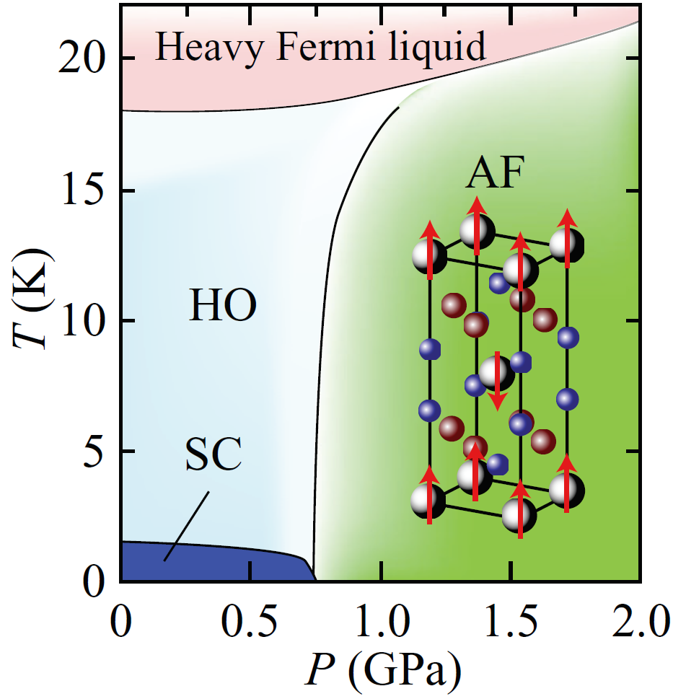
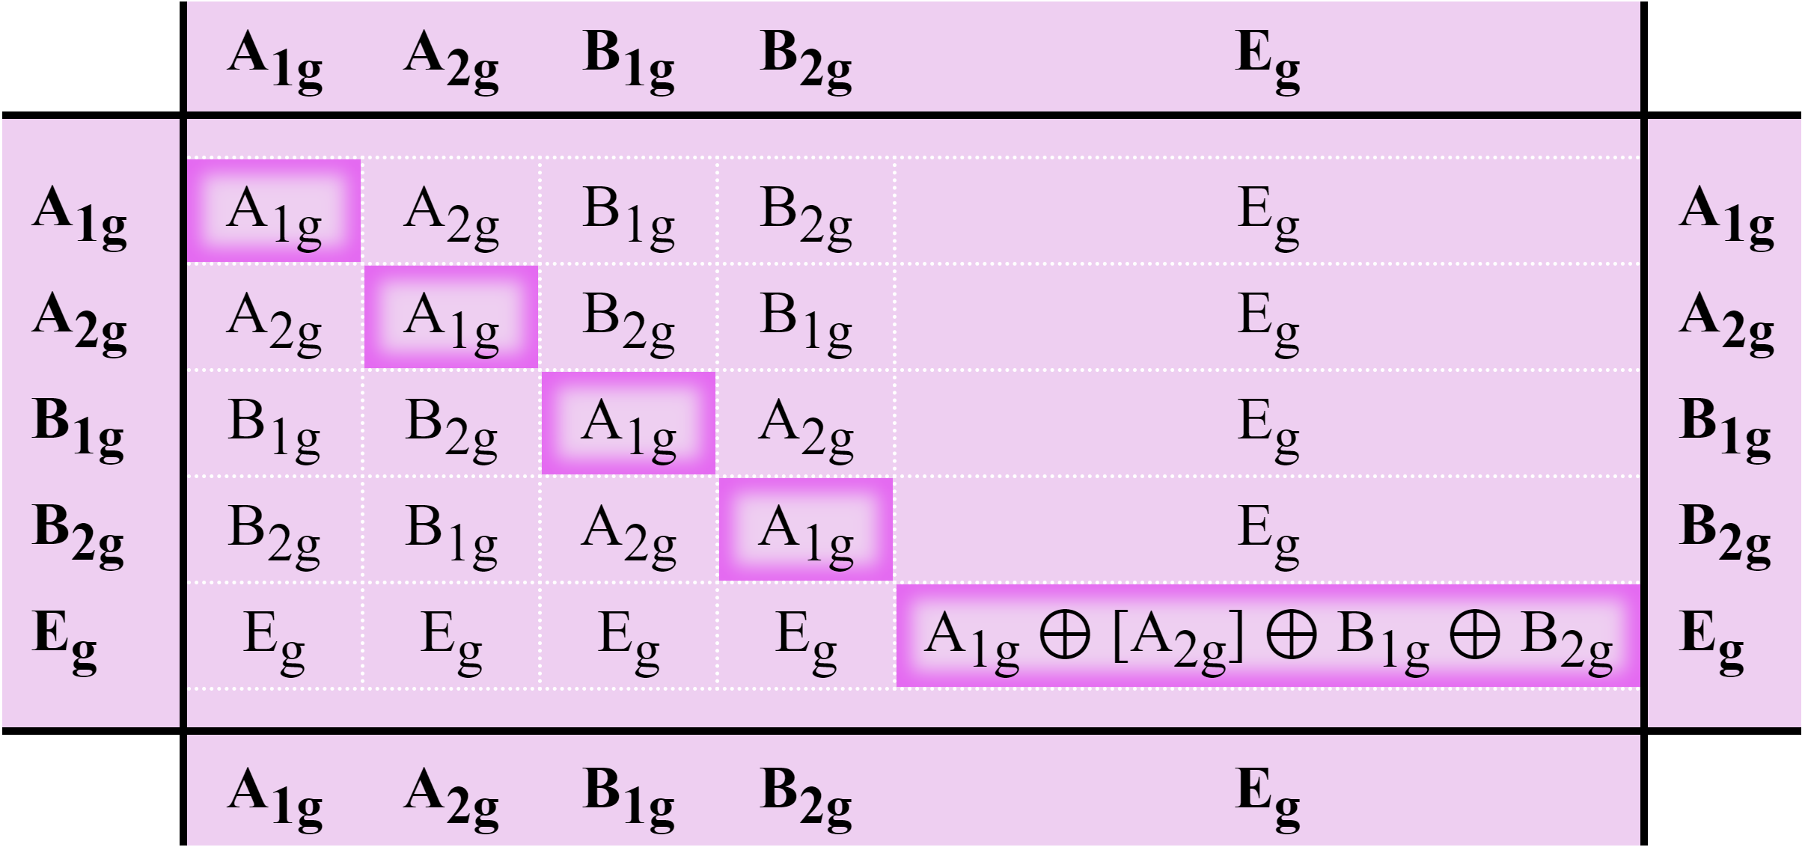
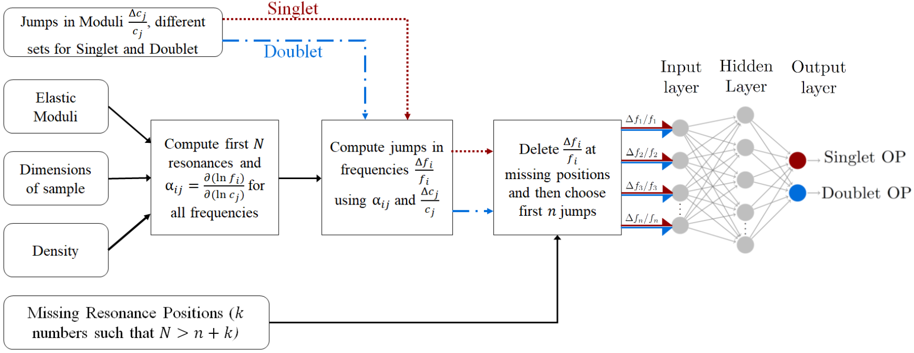
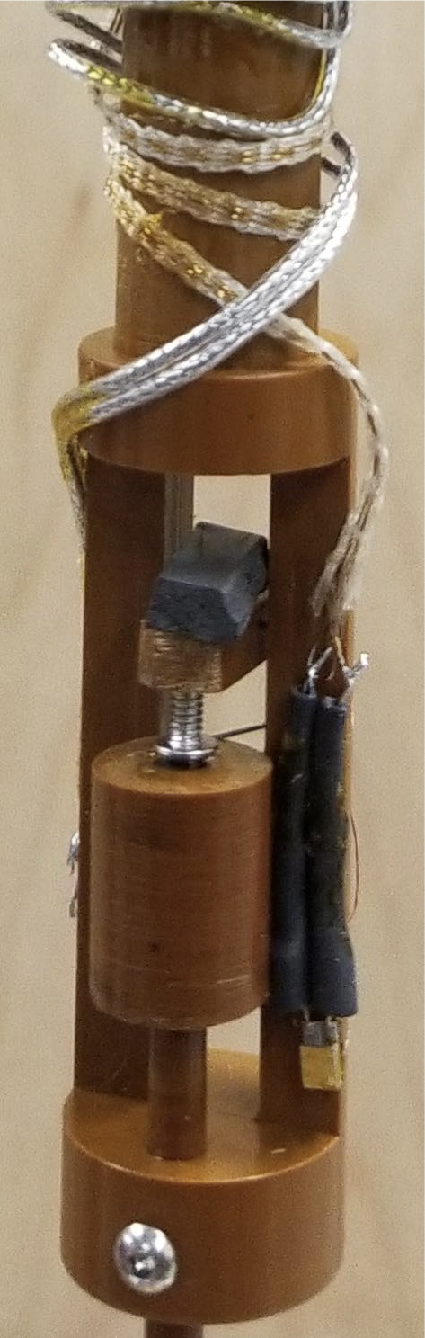
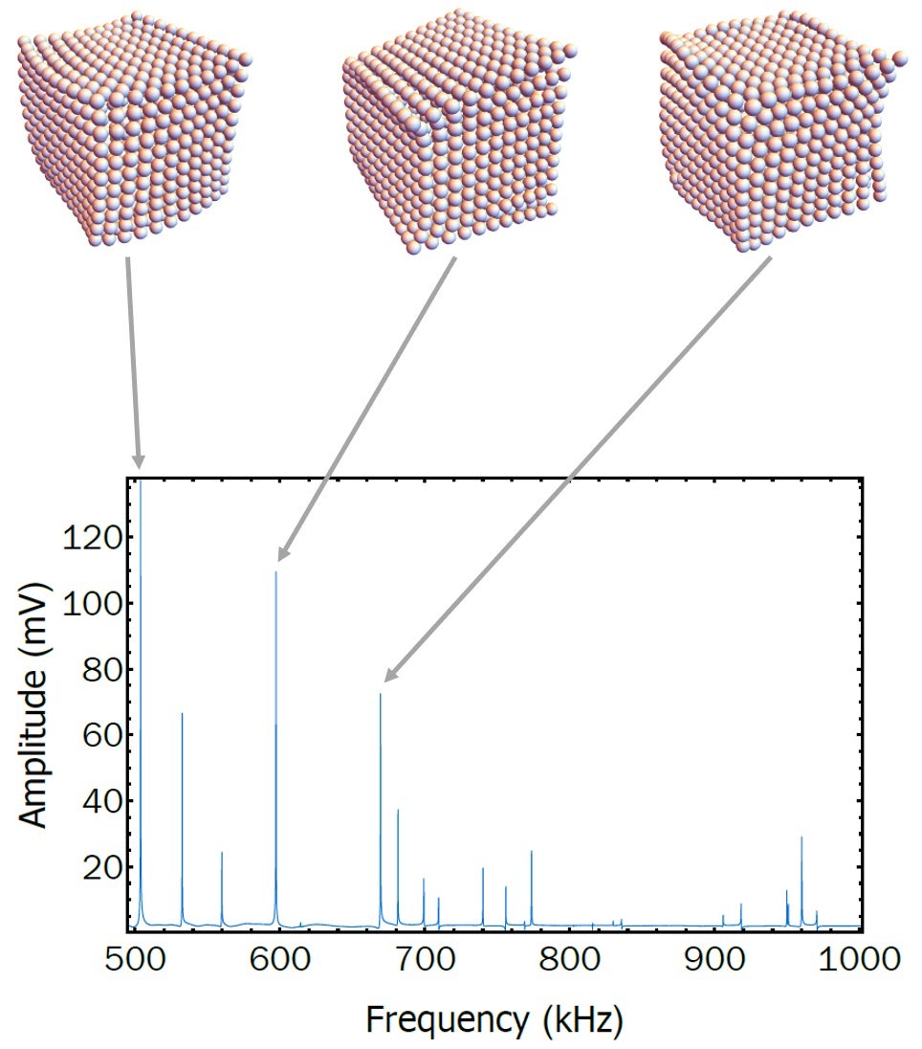
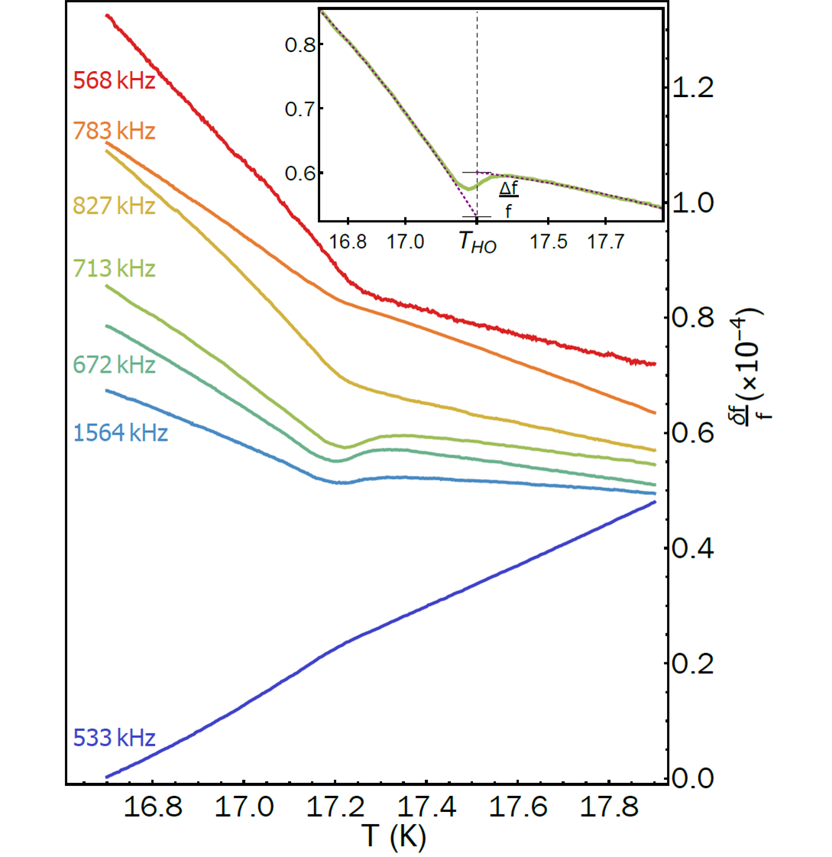
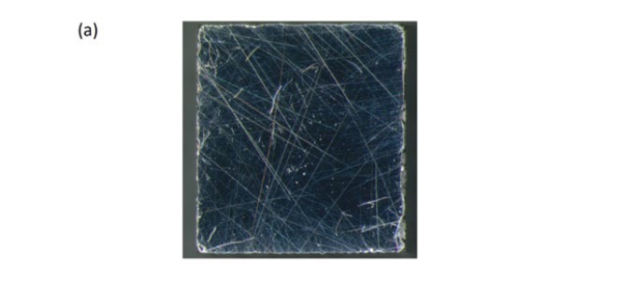
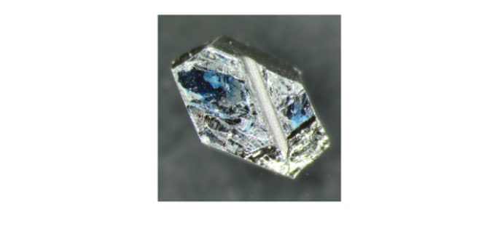
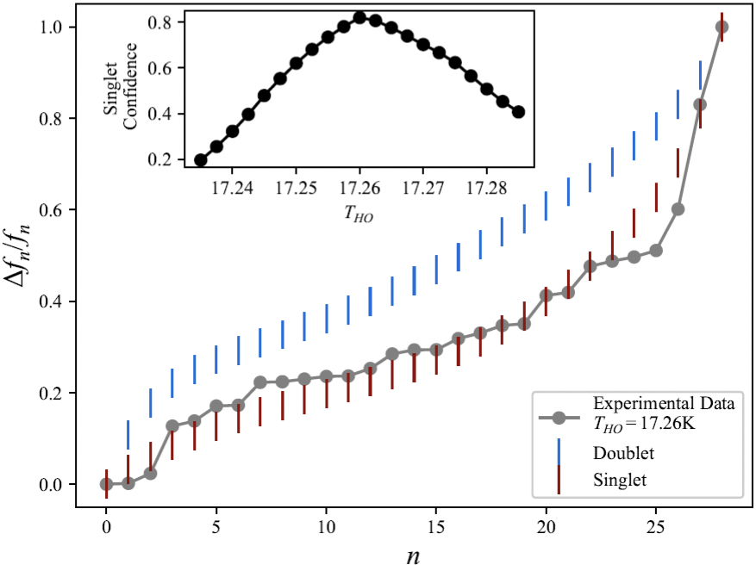
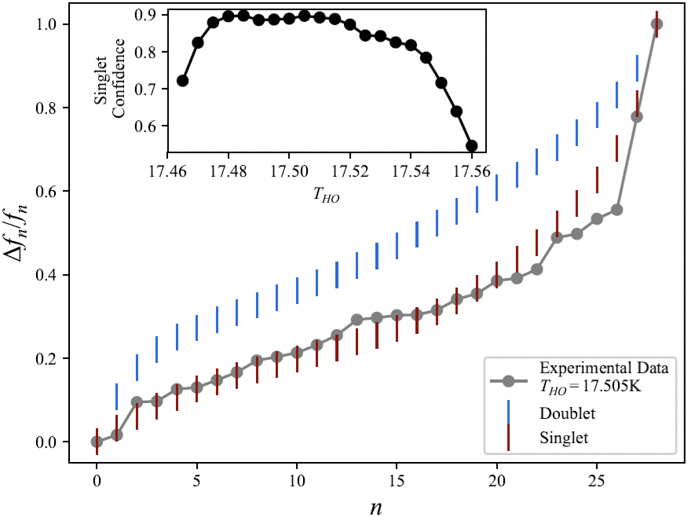
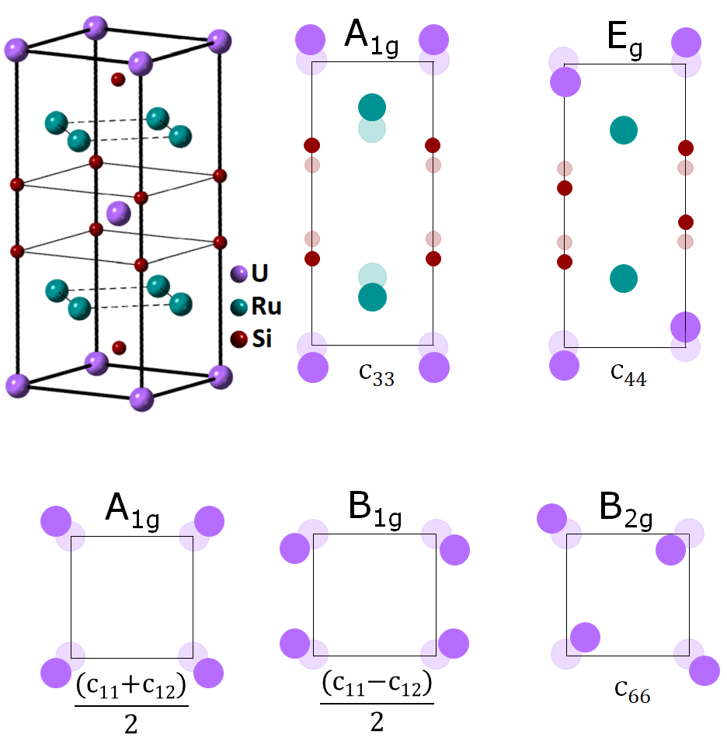
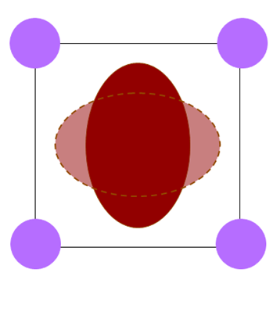
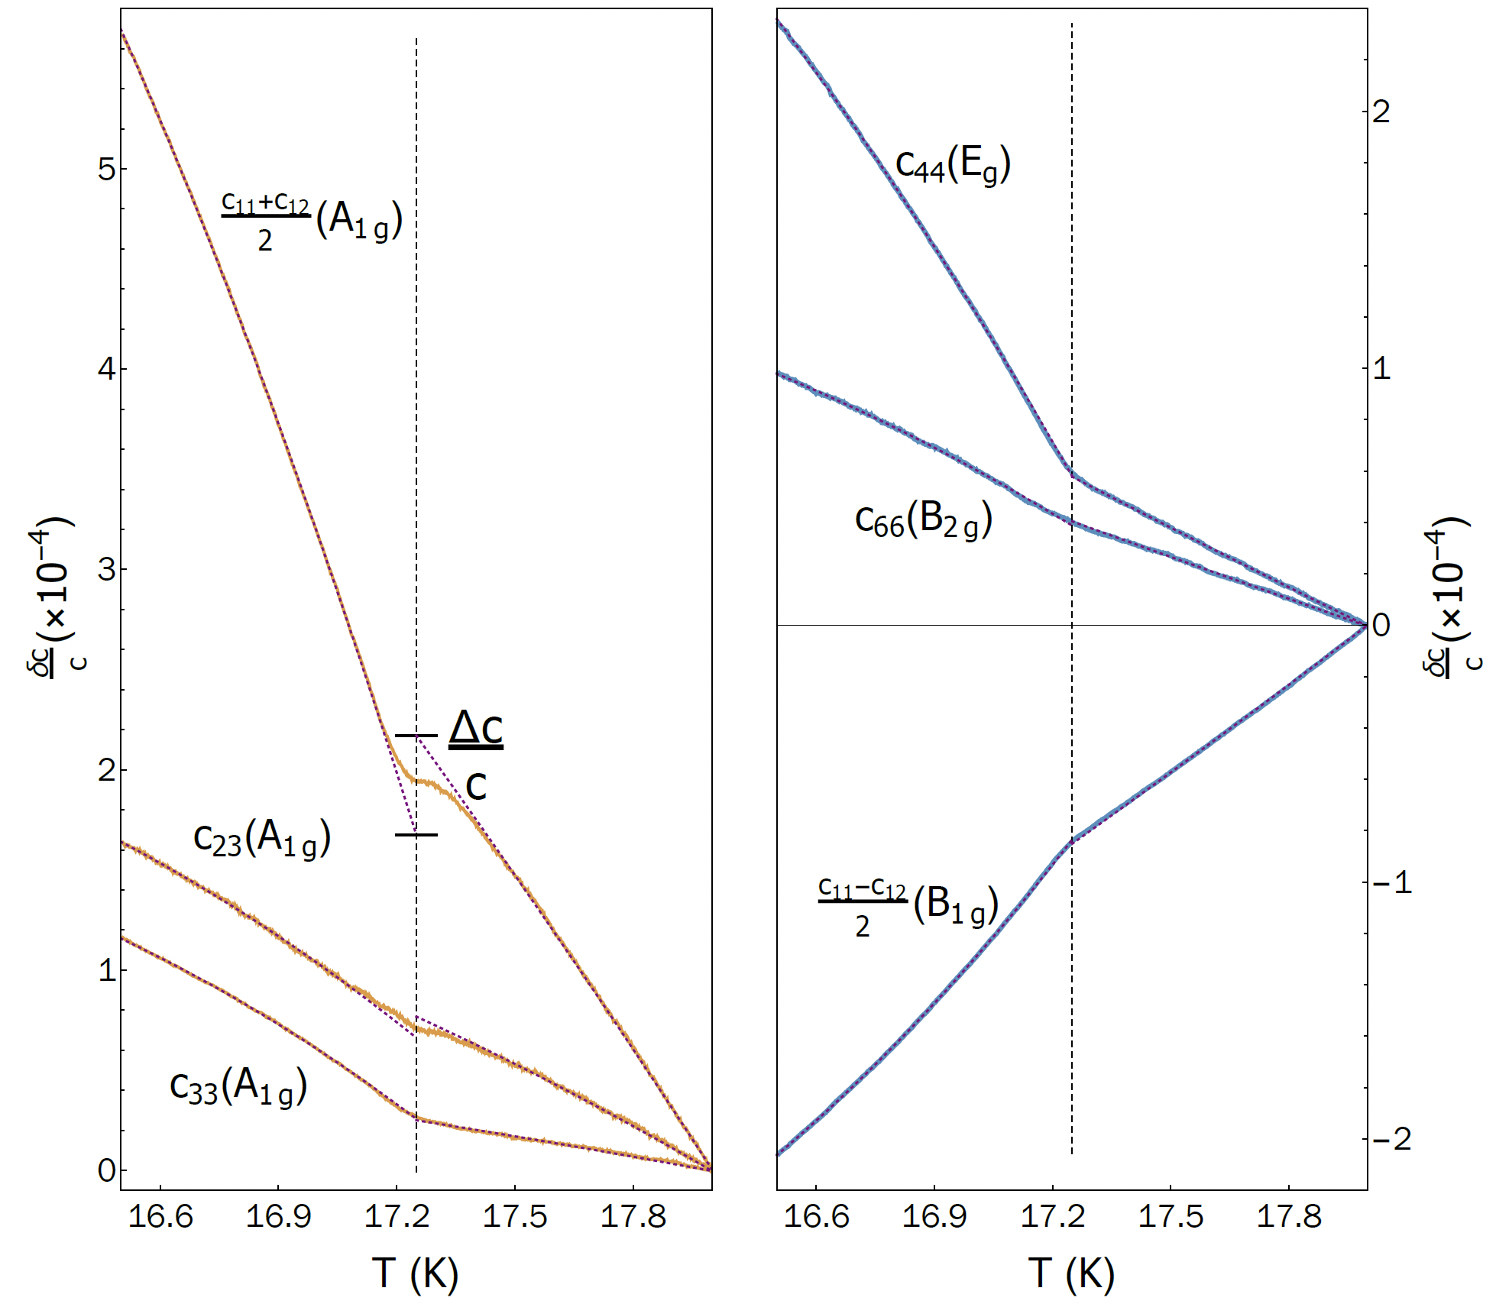
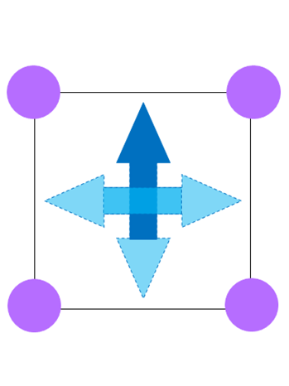


Single-Component Order Parameter in URu₂Si₂ Uncovered by Resonant Ultrasound Spectroscopy and Machine Learning (arXiv: 1903.00552)
Michael Matty¹, Sayak Ghosh¹, Ryan Baumbach², Eric D. Bauer³, K.A. Modic⁴, Arkady Shekhter², J.A. Mydosh⁵, Eun-Ah Kim¹ and B.J. Ramshaw¹
¹Department of Physics, Cornell University, USA; ²National High Magnetic Field Laboratory, USA; ³Los Alamos National Laboratory, USA; ⁴Max-Planck-Institute for Chemical Physics of Solids, Germany; ⁵Leiden University, The Netherlands
Abstract
Elastic moduli jumps related to OP Dimensionality
Machine Learning can classify OP dimensionality
The superconductivity in URu2Si2 condenses from an unusual correlated state called ‘Hidden Order’, which onsets at T_{HO}=17.5 K. The order parameter(OP) characterizing this state has stayed ‘hidden’ for over 30 years. We use resonant ultrasound spectroscopy(RUS), coupled with a novel machine learning based analysis technique, to constrain the order
parameter to be single-component(singlet).
Fig. 1: Phase Diagram of URu₂Si₂
The framework we have developed should be readily applicable to other correlated states of matter, such as the pseudogap in cuprates, and the superconductivity of Sr2RuO4
Fig. 7: Training data generation and artificial neural network
Fig. 4: Irrep tensor product table for tetragonal group D_{4h}
Larger URU₂Si₂ samples are lower quality
Traditional analysis fails for smaller samples:
  Missing resonances
  Ill defined sample geometry
We know that OP symmetry affects typical jump size
Design ANN to classify RUS spectra by OP dimensionality, even with missing peaks and ill defined sample geometry!
Resonant Ultrasound Spectroscopy Experiments
Strain ε_{k} couples to OP η → discontinuity in modulus
For HO transition, lowest order coupling is η²ε_{k}
A_{1g}, A_{2g}, B_{1g}, B_{2g} → Singlet, E_{g} → Doublet
Elastic moduli jumps classify OP dimensionality because OP bilinears couple to different moduli
Solving elastic equation for larger sample suggests singlet OP
ANN finds single component OP for both samples
(a)
(b)
Fig. 2: RUS setup and spectrum
RUS measures mechanical resonances of a single crystal
Measures full elastic tensor simultaneously
At each resonance, strain field decomposes in terms of irreps of URu₂Si₂ point group
Fig. 5: Temperature evolution of representative resonances
Calculate elastic moduli through T_{HO}
Jumps in two A_{1g} moduli, no jumps in shear moduli
Thermodynamic evidence for singlet OP
Fig. 8: ANN analysis for two samples of URu₂Si₂, (a) S1 and (b) S2
S2 has higher T_{HO} than S1 → higher quality
Singlet confidence from ANN peaks near experimental T_{HO}
ANN classifies the OP as singlet for both samples!
Singlet
Conclusions, outlook, and acknowledgements
Both analyses support singlet OP
Result independent of microscopic mechanism
Can extend RUS to materials where large single crystals unavailable
ML framework transferable to other spectroscopic techniques like NMR
Figure 1 from Kasahara et al., New J. Phys., 11, 055061 (2009)
Figs. 2,3,5-8 from Ghosh, Matty et al., arXiv:1903.00552 (2019).
Doublet
Fig. 3: Irreps of strain in URu2Si2 and
examples of singlet and doublet OP’s
Fig. 6: Temperature evolution of URu₂Si₂ elastic moduli
Add your information, graphs and images to this section.

